Slide 1
COMP3013 DBMS Lab 6
United International College

Slide 2
Data Definition
In lectures, we have introduced conceptual designs (ER diagrams) and logical designs (schemas).
In this lab, we will implement the logical design in MySQL.
Data definition language defines
Databases
Tables
Attributes and their types
Constraints

Slide 3
Create Database
CREATE DATABASE uic_example
Suppose the database is called “uic_example”.
Execute the query. Then, the new database will appear in the database list.

Slide 4
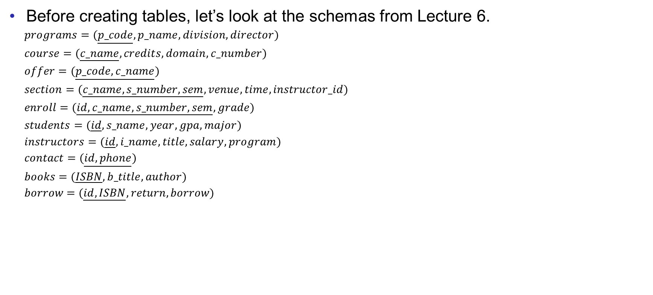
Create Tables
Before creating tables, let’s look at the schemas from Lecture 6.
$programs=(\underline{p_code},p_name,division,director)$
$course=(\underline{c_name},credits,domain,c_number)$
$offer=(\underline{p_code,c_name})$
$section=(\underline{c_name,s_number,sem},venue,time,instructor_id)$
$enroll=(\underline{id,c_name,s_number,sem}, grade)$
$students=(\underline{id},s_name,year,gpa,major)$
$instructors=(\underline{id},i_name,title,salary,program)$
$contact=(\underline{id,phone})$
$books=(\underline{ISBN},b_title,author)$
$borrow=(\underline{id,ISBN},return,borrow)$

Slide 5
Create Tables
To create tables, we use
CREATE TABLE table_name (
attribute1 type1,
attribute2 type2,
…
constraint1,
constraint2,
…
)
“table_name” is the name of the table.
“attribute” is the name of the attribute.
“type” is the data type for the attribute.
“constraint” is a condition on the table. If users try to insert some data violating the condition, the system will give a warning.

Slide 6
Example
CREATE TABLE book(
ISBN INT,
b_title VARCHAR(40) NOT NULL,
author VARCHAR(20),
PRIMARY KEY (ISBN)
)
Remember to select the database “UIC” before executing the query.
Table name
Attribute name
Data types
Constraints

Slide 7
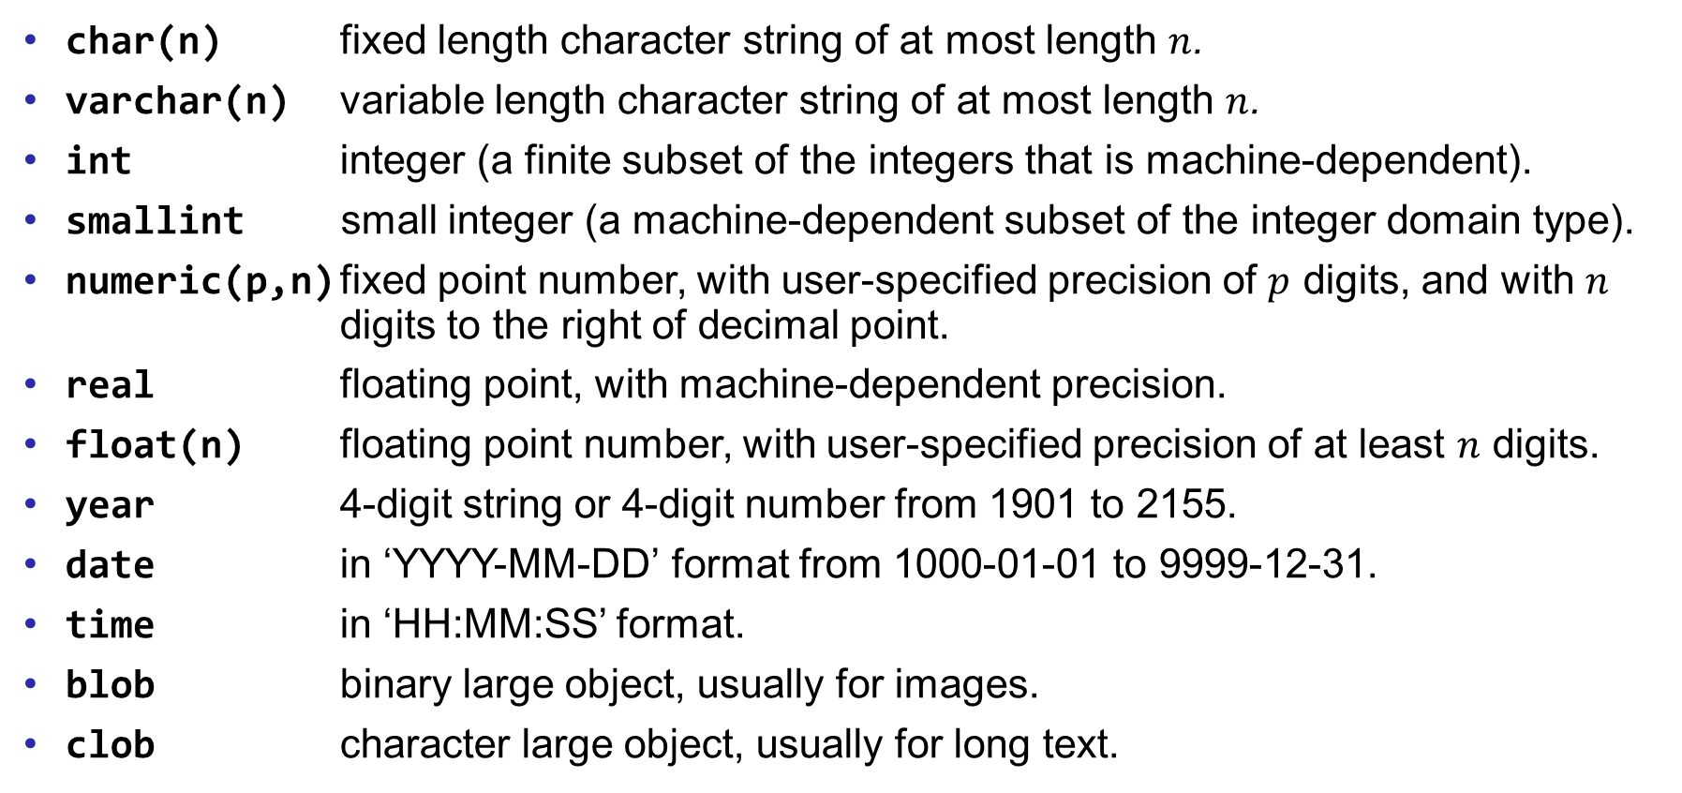
Data Types
char(n) fixed length character string of at most length $n$.
varchar(n) variable length character string of at most length $n$.
int integer (a finite subset of the integers that is machine-dependent).
smallint small integer (a machine-dependent subset of the integer domain type).
numeric(p,n) fixed point number, with user-specified precision of $p$ digits, and with $n$ digits to the right of decimal point.
real floating point, with machine-dependent precision.
float(n) floating point number, with user-specified precision of at least $n$ digits.
year 4-digit string or 4-digit number from 1901 to 2155.
date in ‘YYYY-MM-DD’ format from 1000-01-01 to 9999-12-31.
time in ‘HH:MM:SS’ format.
blob binary large object, usually for images.
clob character large object, usually for long text.

Slide 8
Constraints
PRIMARY KEY (attribute)
One or multiple attribute(s)
Uniquely identify the tuples
Unique for each table
Cannot be a NULL value by default
NOT NULL
The value of the attribute cannot be unknown.
The condition is checked when rows are inserted into the table.

Slide 9
Example
Define the table for “borrow”.
CREATE TABLE borrow(
id INT NOT NULL,
ISBN INT NOT NULL,
return_date DATE,
borrow_date DATE NOT NULL,
PRIMARY KEY (id, ISBN)
)

Slide 10
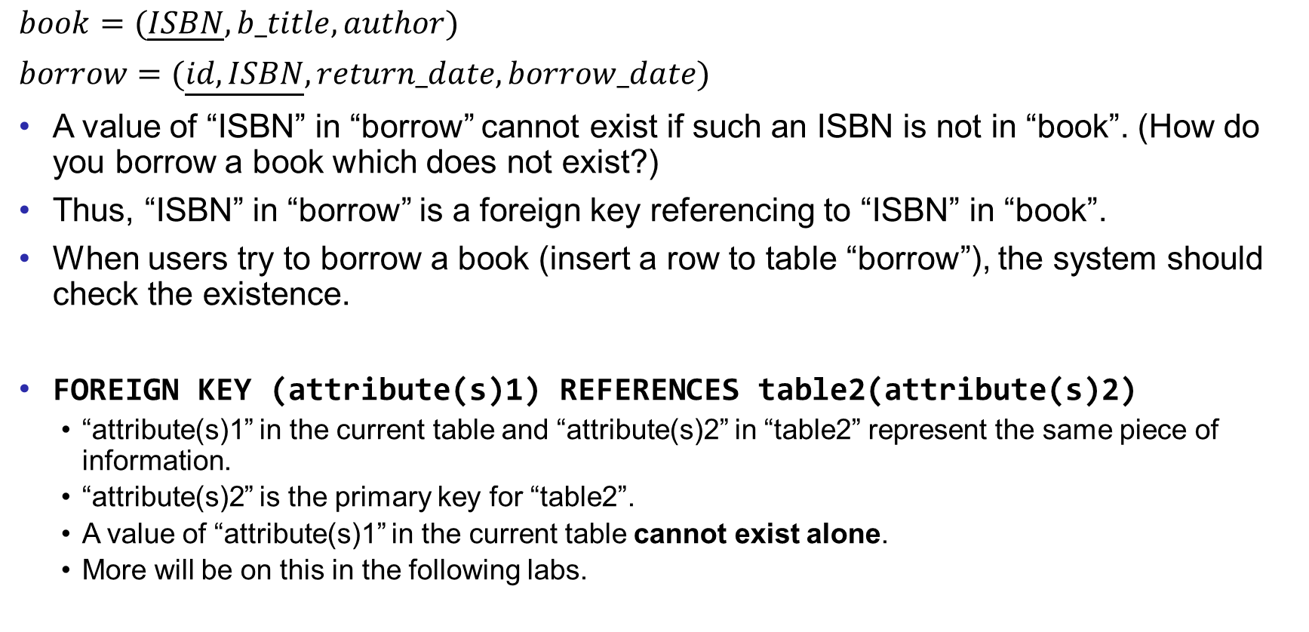
Foreign key
$book=(\underline{ISBN},b_title,author)$
$borrow=(\underline{id,ISBN},return_date,borrow_date)$
A value of “ISBN” in “borrow” cannot exist if such an ISBN is not in “book”. (How do you borrow a book which does not exist?)
Thus, “ISBN” in “borrow” is a foreign key referencing to “ISBN” in “book”.
When users try to borrow a book (insert a row to table “borrow”), the system should check the existence.
FOREIGN KEY (attribute(s)1) REFERENCES table2(attribute(s)2)
“attribute(s)1” in the current table and “attribute(s)2” in “table2” represent the same piece of information.
“attribute(s)2” is the primary key for “table2”.
A value of “attribute(s)1” in the current table cannot exist alone.
More will be on this in the following labs.

Slide 11
Foreign key
To add foreign keys to an existing table, we need to change the schema.
ALTER TABLE borrow ADD FOREIGN KEY (ISBN) REFERENCES books(ISBN)
ALTER TABLE: the keyword to change the schema of a table.
borrow: the table name.
ADD: to add new attributes or constraints (“DROP” to remove attributes or constraints).
FOREIGN KEY: the constraint.
(ISBN): the foreign key.
REFERENCES: the keyword to indicate which attribute is the target.
books(ISBN): the attribute “ISBN” in the table “books” is referenced.

Slide 12
Exercises
Implement the logical design in MySQL
Create one table for each of the schema.
Define the primary key.
Define the suitable data type for each attribute.
Define the foreign keys.
Save your queries in a txt file. Rename it as “COMP3013 Lab6 ###.txt”, where “###” is your student ID. And submit it on iSpace. The DDL is 24 hours after the lab.

